Slide 1

Is it possible to predict the popularity of a book by its characteristics?
FINAL PROJECT
Assigned by Yaniv Levizada
Using Data Scraping and Machine Learning methods

Slide 2

Elaboration on research phases
1. Data Acquisition – Crawling the website we want to fetch the information from, and gathering it all in one csv file.
2. EDA – Filtering and cleaning the data, analyzing it and visualizing insights based on the data we acquired.
3. Machine Learning – Using ML techniques to help us predict popularity of a book, and benchmarking the performance of the models.
4. Conclusions – Stating conclusions from the model regarding our research question.

Slide 3
Data sources
Data acquisition using scraping:
GoodReads
Note: Some websites want to prevent us from flooding their sites with requests or prevent automation, therefore they use pop-ups or any other techniques to prevent us doing so.
Fun Fact: Web scraping is about extracting the data from one or more websites, While crawling is about exploring URLs on the web.
Data Acquisition
EDA
Machine Learning
Conclusions
WOW EFFECT

Slide 4
EDA (exploratory data analysis)
Filtering unwanted values such as nulls, checking for correlations in the data, balancing the data (there were too many book labels rated with 4 stars)
Visualizing the data to gain insights and understand the structure of our data set.
There were no duplicates in the data set as we iterated by chunks of a few millions on each iteration.
Handling outliers – Usually only numeric feature should be handled, in our data set – we will clean outliers that might mislead our model (# of pages and # of reviews)
Data Acquisition
EDA
Machine Learning
Conclusions
WOW EFFECT

Slide 5
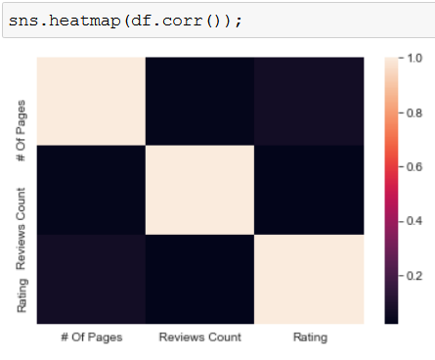
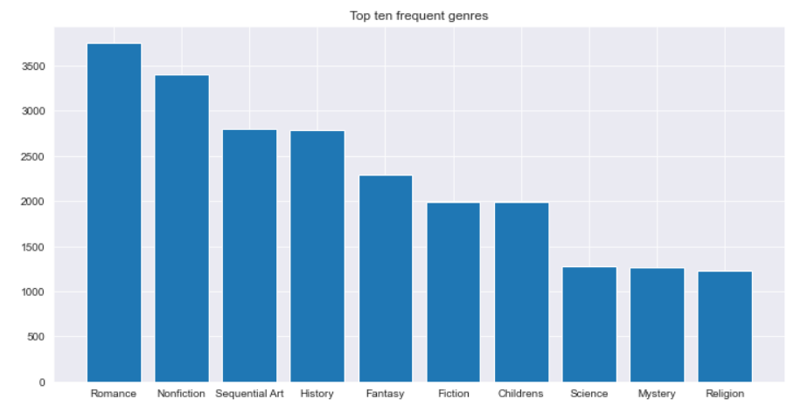
Let’s observe some insights:
There’s an insignificant correlation between the features in our data. (Which is good because correlation indicates dependency, which we DON’T want to see.
An histogram that describes the top 10 most frequent genres in the data set. Romance is most frequent section, followed by non-fiction (מציאותי)
WOW EFFECT
Conclusions
Machine Learning
EDA
Data Acquisition

